Slide 1
Prometheus
Prometheus is an open-source technology designed to provide monitoring and alerting functionality for cloud-native environments, including Kubernetes.
It can collect and store metrics as time-series data, recording information with a timestamp.
It can also collect and record labels, which are optional key-value pairs.

Slide 2
Prometheus Features
Multidimensional data model – Using time-series data, which is identified by metric name and key-value pairs.
PromQL – A flexible querying language that can leverage the multi-dimensional data model.
No reliance on distributed storage – All single server nodes remain autonomous.
Pull model – Prometheus can collect time-series data by actively “pulling” data over HTTP.
Pushing time-series data – Available through the use of an intermediary gateway.
Monitoring target discovery – Available through static configuration or service discovery.
Visualization – Prometheus offers multiple types of graphs and dashboards.

Slide 3
Micrometer Prometheus
Micrometer provides a simple facade over the instrumentation clients for the most popular monitoring systems.
It allows us to instrument JVM-based application code without vendor lock-in.
Micrometer is an open-source project and provides a metric facade that exposes metric data in a vendor-neutral format that a monitoring system can understand.

Slide 4
Monitoring Systems
These monitoring systems are supported:
AppOptics
Azure Monitor
Netflix Atlas
CloudWatch
Datadog
Dynatrace
Elastic
Ganglia
Graphite
Humio
Influx/Telegraf
JMX
KairosDB
New Relic
Prometheus
SignalFx
Google Stackdriver
StatsD
Wavefront

Slide 5
How Does Prometheus Monitoring Work?
To get metrics, Prometheus requires an exposed HTTP endpoint.
Once an endpoint is available, Prometheus can start scraping numerical data, capture it as a time series, and store it in a local database suited to time-series data.
Prometheus can also be integrated with remote storage repositories.

Slide 6
How Does Prometheus Monitoring Work?
Users can leverage queries to create temporary times series from the source.
These series are defined by metric names and labels.
Queries are written in PromQL, a unique language that allows users to choose and aggregate time-series data in real time.
PromQL can also help us establish alert conditions, resulting in notifications to external systems like email, PagerDuty, or Slack.

Slide 7
How Does Prometheus Monitoring Work?
Prometheus can display collected data in tabular or graph form, shown in its web-based user interface.
We can also use APIs to integrate with third-party visualization solutions like Grafana.

Slide 8
What Can You Monitor with Prometheus?
Prometheus is a versatile monitoring tool, which you can use to monitor a variety of infrastructure and application metrics.
Use Cases
Service Metrics
Host Metrics
Website Uptime/Up Status
Cronjobs

Slide 9
Service Metrics
Prometheus is typically used to collect numeric metrics from services that run 24/7.
It allows metric data to be accessed via HTTP endpoints.
This can be done manually or with various client libraries.
Prometheus exposes data using a simple format, with a new line for each metric, separated with line feed characters.
The file is published on an HTTP server that Prometheus can query and scrape metrics from based on the specified path, port, and hostname.
Prometheus can also be used for distributed services, which are run on multiple hosts.
Each instance publishes its own metrics and has a name that Prometheus can distinguish.

Slide 10
Host Metrics
We can monitor the operating system to identify when a server’s hard disk is full or if a server operates constantly at 100% CPU.
We can install a special exporter on the host to collect the operating system information and publish it to an HTTP-reachable location.

Slide 11
Website Uptime/Up Status
Prometheus doesn’t usually monitor website status, but we can use a black box exporter to enable this.
We specify the target URL to query an endpoint.
It performs an uptime check to receive information such as the website’s response time.
We define the hosts to be queried in the prometheus.yml configuration file, using relabel_configs to ensure Prometheus uses the black box exporter.

Slide 12
Cronjobs
To check if a cronjob is running at the specified intervals, we can use the Push Gateway to display metrics to Prometheus through an HTTP endpoint.
We can push the timestamp of the last successful job (i.e. a backup job) to the Gateway, and compare it with the current time in Prometheus.
If the time exceeds the specified threshold, the monitor times out and triggers an alert.

Slide 13
Prometheus Metric Types
The client libraries of Prometheus offer three core types of metrics.
However, the Prometheus server does not currently save these metrics as different data types.
Instead, it flattens all information into an untyped time series.

Slide 14
Prometheus Metric Types
Counter
This is a cumulative metric. It represents a single monotonically-increasing counter, and its value can either increase or be reset to zero on restart.
Gauge
This metric represents one numerical value, which can arbitrarily go down and up.
A gauge is often used to measure values like current memory usage or temperatures.
Histogram
A histogram samples observations, such as request durations or response sizes.
It then counts the observations in a configurable bucket.
A histogram can also provide a total sum of all the observed values.

Slide 15
Prometheus Component Architecture
Prometheus has various components that work together to track and report on system health, behavior, and performance.
The primary method of data collection is scraping metrics from instrumented applications and services, which expose metrics in a plaintext format via HTTP endpoints.
The Prometheus architecture facilitates the discovery and scraping of targets that generate required data.
The target may be a third-party application or a company's instrumented applications.
Prometheus stores the scraped data, which you can analyze with the Prometheus Query Language (PromQL).

Slide 16
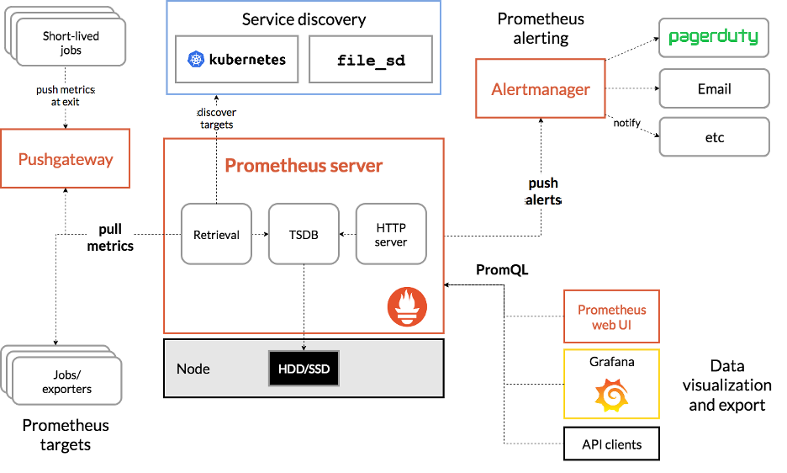
Prometheus Component Architecture

Slide 17
Prometheus Server
The Prometheus server handles the scraping and storing of metrics.
The server manages scheduling of monitoring jobs – querying data sources (called “instances”) at a predefined polling frequency.
Monitoring jobs are configured via one or more “scrape config” directives, managed via a YAML configuration file.
It can be live-reloaded using a SIGHUP or the Management API.

Slide 18
Prometheus Server
Prometheus relies heavily on various service discovery (SD) mechanisms to identify targets to scrape.
These service discovery integrations range from generic interfaces like a file-based service discovery that custom SD implementations can leverage by managing a JSON or YAML file containing a list of targets.

Slide 19
Prometheus Server
Prometheus also provides number of platform-specific SD implementations, including: Kubernetes, AWS EC2, Azure, GCE, Docker Swarm, OpenStack, and more.
These generally integrate with the corresponding APIs to query the platform for targets running applications and exporters that can be scraped by Prometheus.

Slide 20
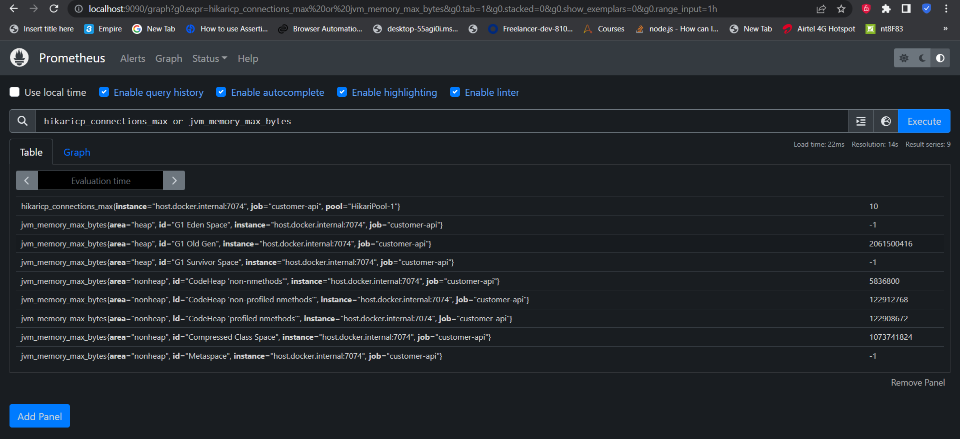
Prometheus Query

Slide 21
Prometheus Exporters
Prometheus servers scrape (i.e. "pull") data from instrumented applications and Prometheus exporters.
Applications are instrumented using client libraries.
It enables an HTTP endpoint where internal metrics are exposed and collected by Prometheus servers.
Other monitoring tools relies on agents or embedded instrumentation (e.g. APM client libraries) to collect data and "push" metrics to the monitoring backend.

Slide 22
Prometheus Exporters
Exporters are libraries and servers which help in exporting existing metrics from third-party systems as Prometheus metrics”.
Exporters are useful in cases where it is not feasible to instrument a given system with Prometheus directly (for example, HAProxy or Linux system stats)”.
Exporters are "single-purpose monitoring agents“.
It is designed to collect metrics from a specific third-party system and make them available for Prometheus servers to collect.

Slide 23
Example: The Prometheus Node Exporter
The Prometheus node_exporter is an exporter for physical and virtual machine metrics – hardware and kernel metrics exposed by *NIX kernels.
A Windows exporter is also available for Windows hosts.
The exact number of distinct metrics collected by node_exporter will vary from system to system.
It has some optional collectors are disabled by default for performance and reliability reasons.

Slide 24
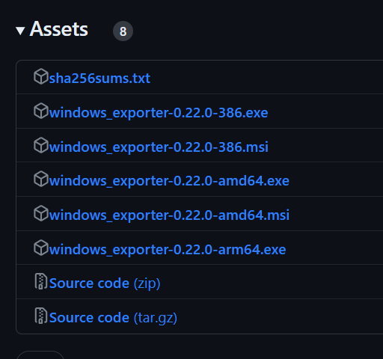
Windows Exporter
https://github.com/prometheus-community/windows_exporter/releases

Slide 25
Windows Exporter
http://localhost:9182/metrics

Slide 26
Node Exporter
The Prometheus Node Exporter exposes a wide variety of hardware- and kernel-related metrics.
In this guide, you will:
Start up a Node Exporter on localhost
Start up a Prometheus instance on localhost that's configured to scrape metrics from the running Node Exporter

Slide 27
Node Exporter
docker run -d -p 9100:9100 --net="boanetwork" prom/node-exporter
Metric | Meaning
rate(node_cpu_seconds_total{mode="system"}[1m]) | The average amount of CPU time spent in system mode, per second, over the last minute (in seconds)
node_filesystem_avail_bytes | The filesystem space available to non-root users (in bytes)
rate(node_network_receive_bytes_total[1m]) | The average network traffic received, per second, over the last minute (in bytes)

Slide 28
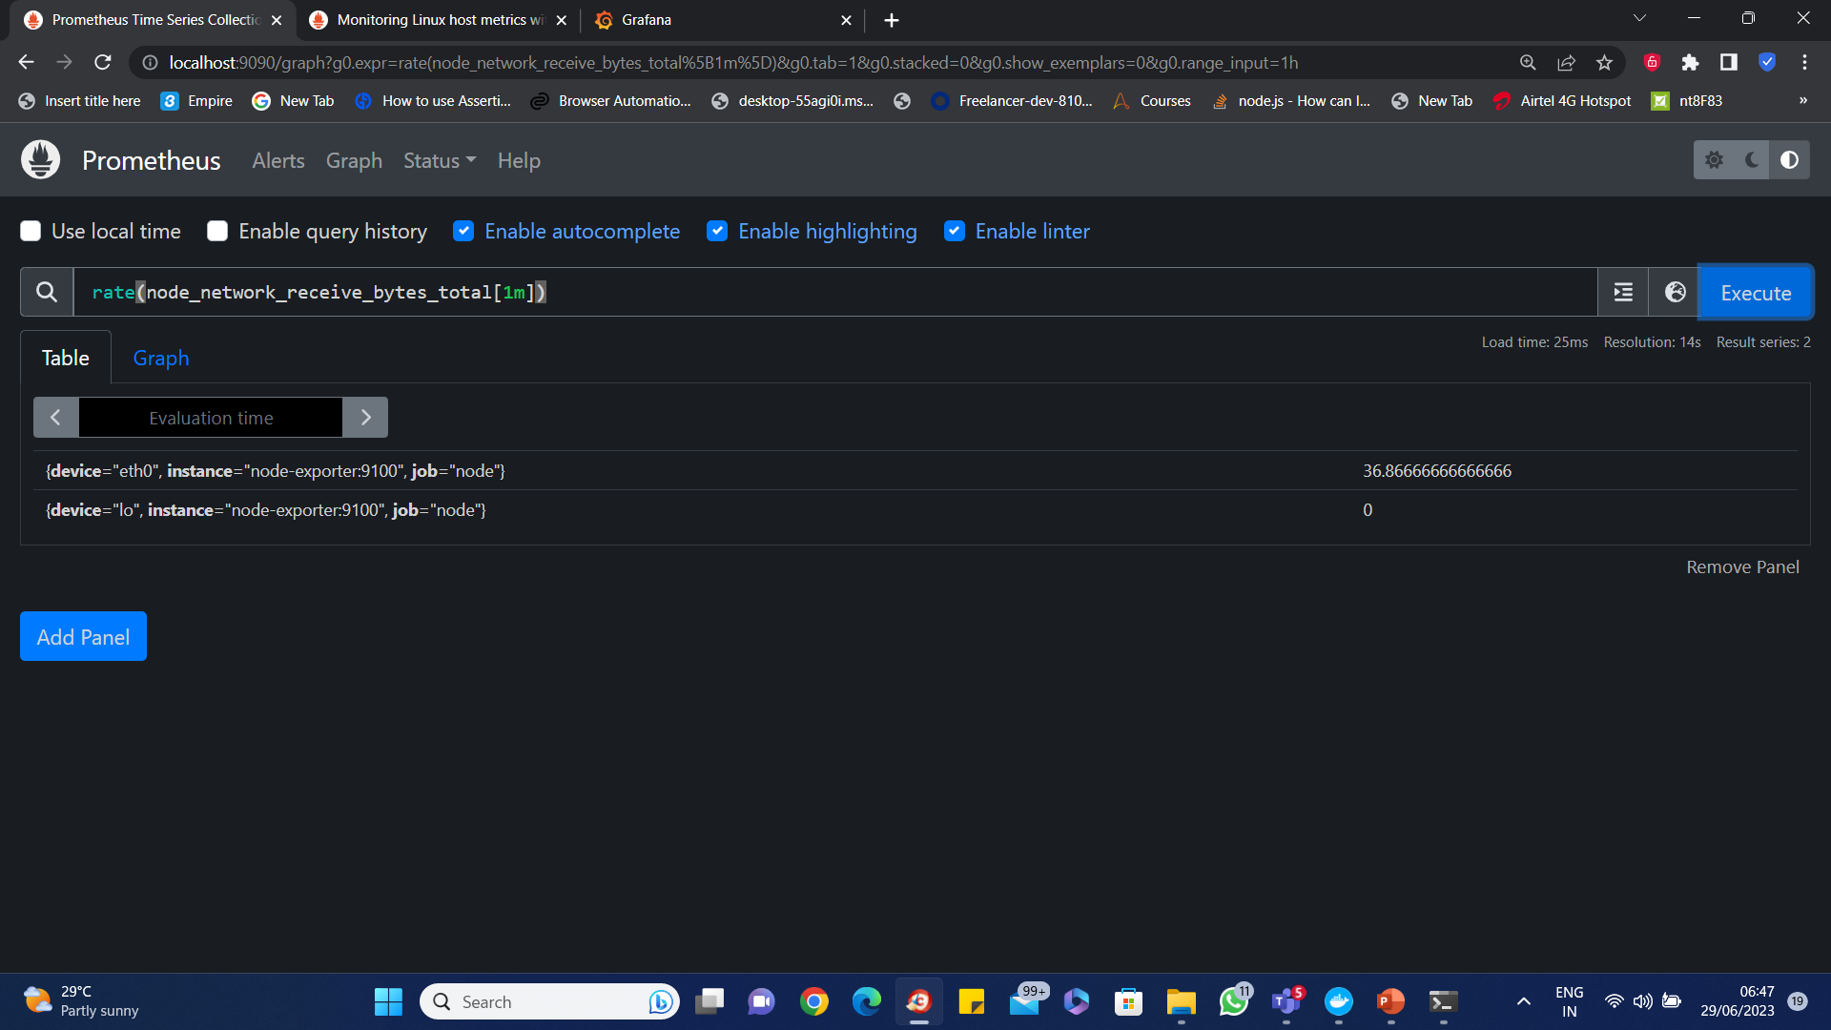
Node Exporter

Slide 29
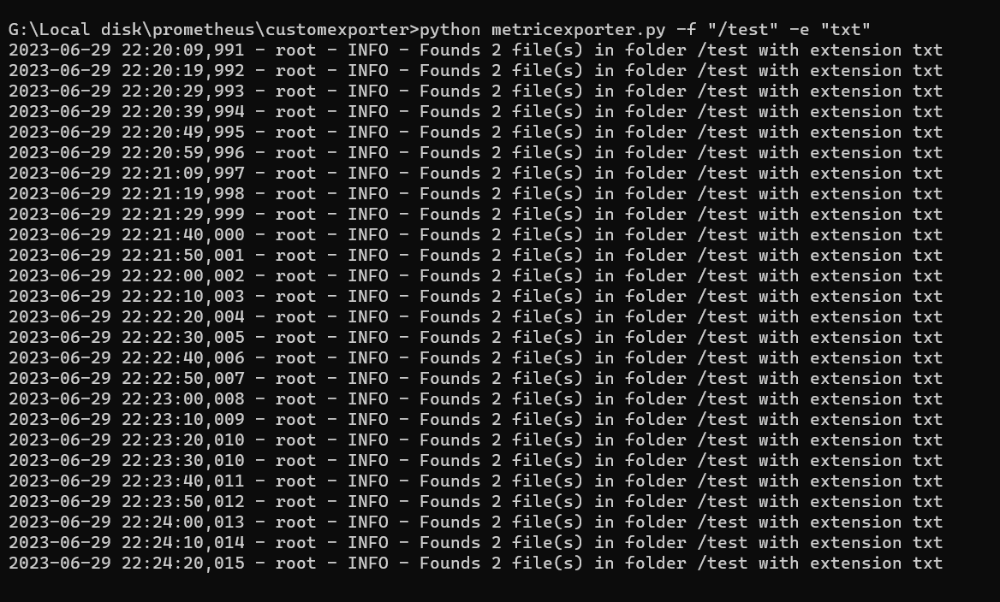
Custom Exporter

Slide 30
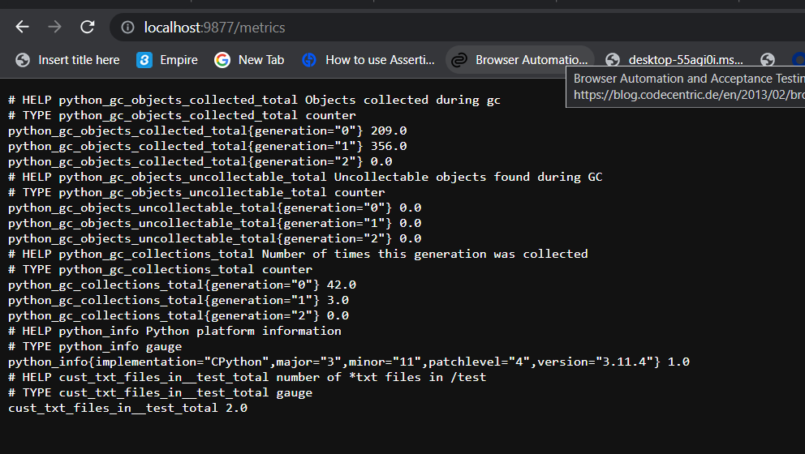
Custom Exporter

Slide 31
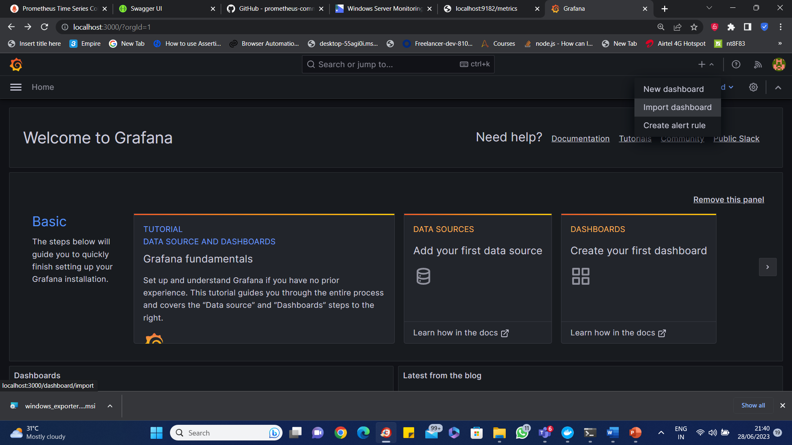
Grafana

Slide 32
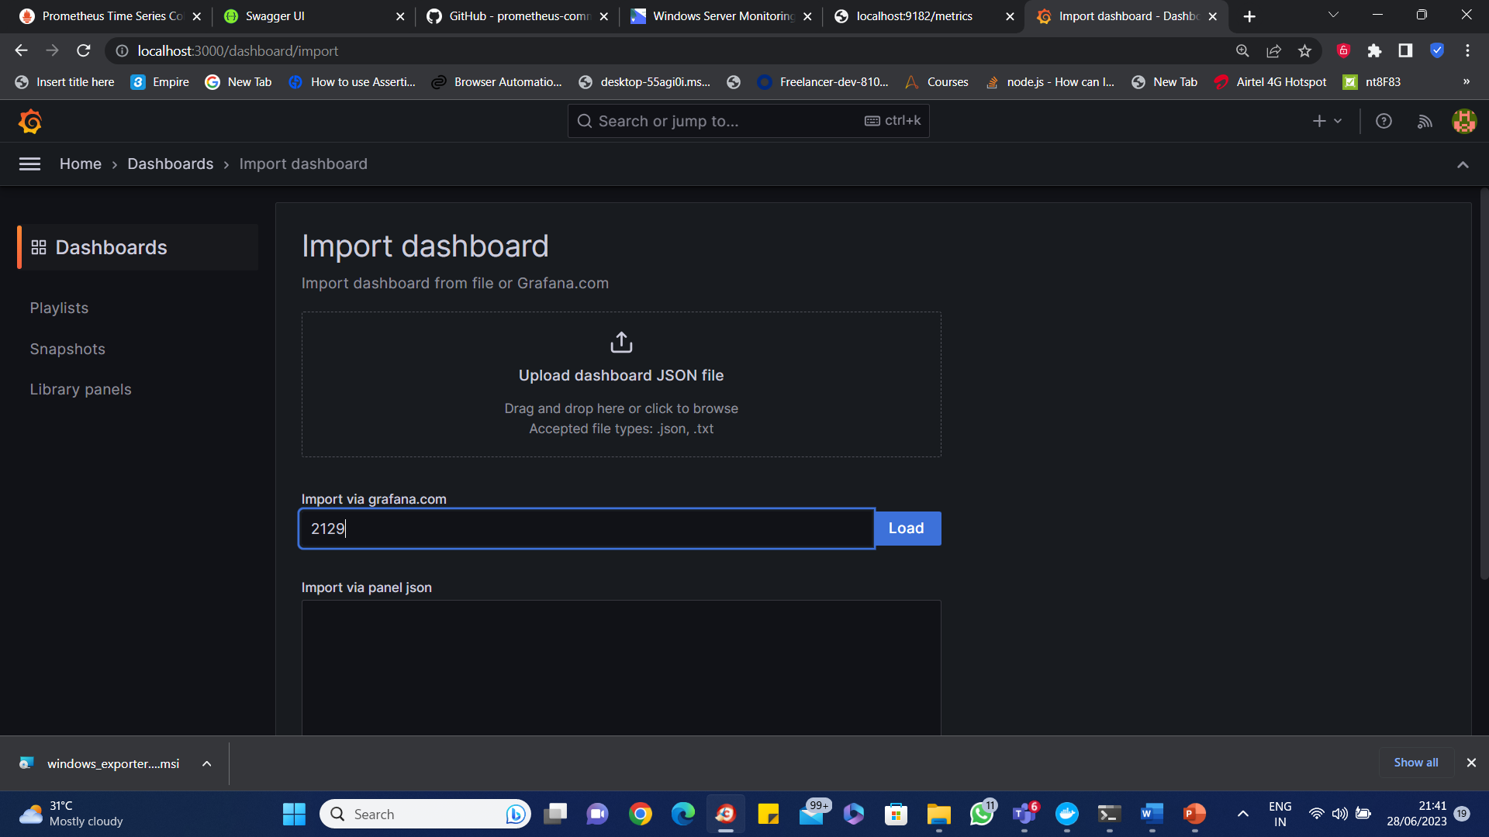
Grafana

Slide 33
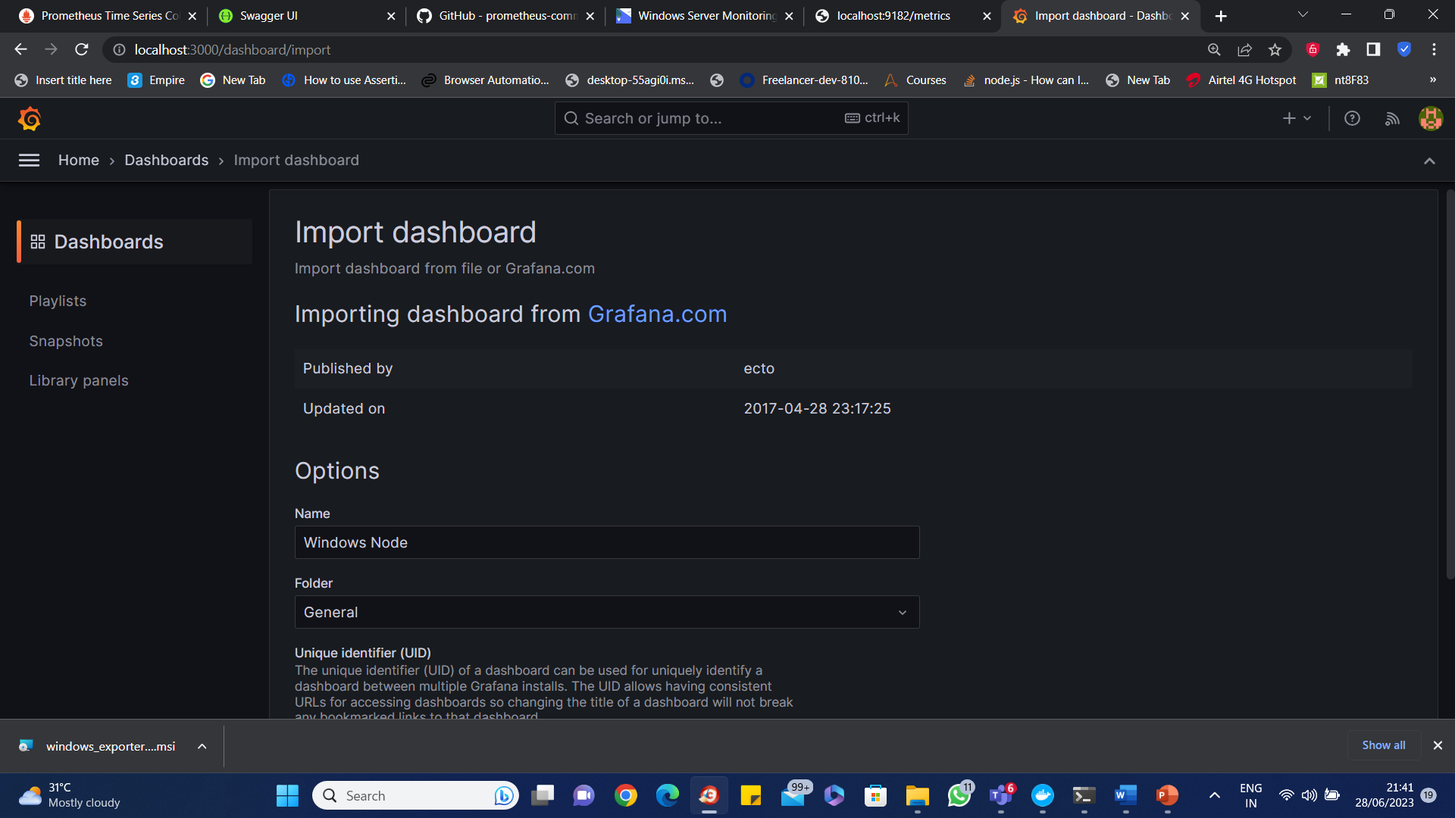
Grafana

Slide 34
Example: The Prometheus Node Exporter
The Prometheus node_exporter is officially distributed as a binary archive.
Like other exporters, the node_exporter must be configured to listen on a dedicated port (9100 by default).
For example, if a host is running a MySQL database, the official Prometheus MySQL exporter would expose metrics on port 9104 by default.
Node_exporter would expose machine metrics on port 9100.
Caution is advised to avoid prolonged runtimes (as measured by the built-in scrape_duration_seconds metric).

Slide 35
Statsd-Exporter
The statsd-exporter is used to convert Statsd metrics into Prometheus metrics.
This is because the StatsD text-format represents metrics differently to Prometheus' exposition format which is represented like this:
<time series name>{<label name>=<label value>,...}

Slide 36
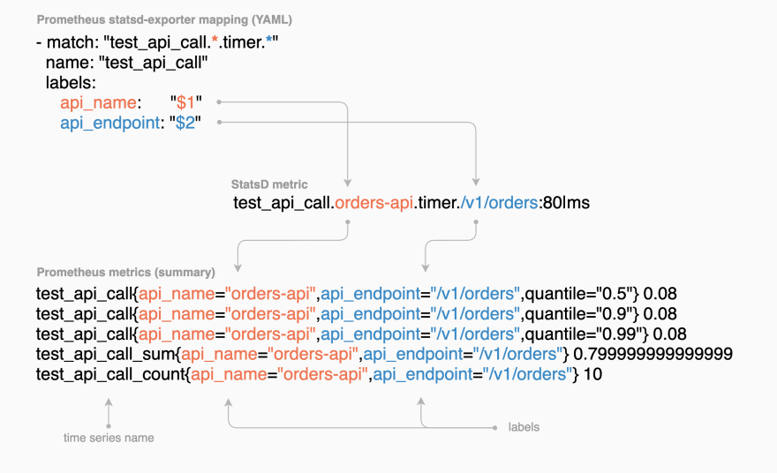
Statsd-Exporter

Slide 37
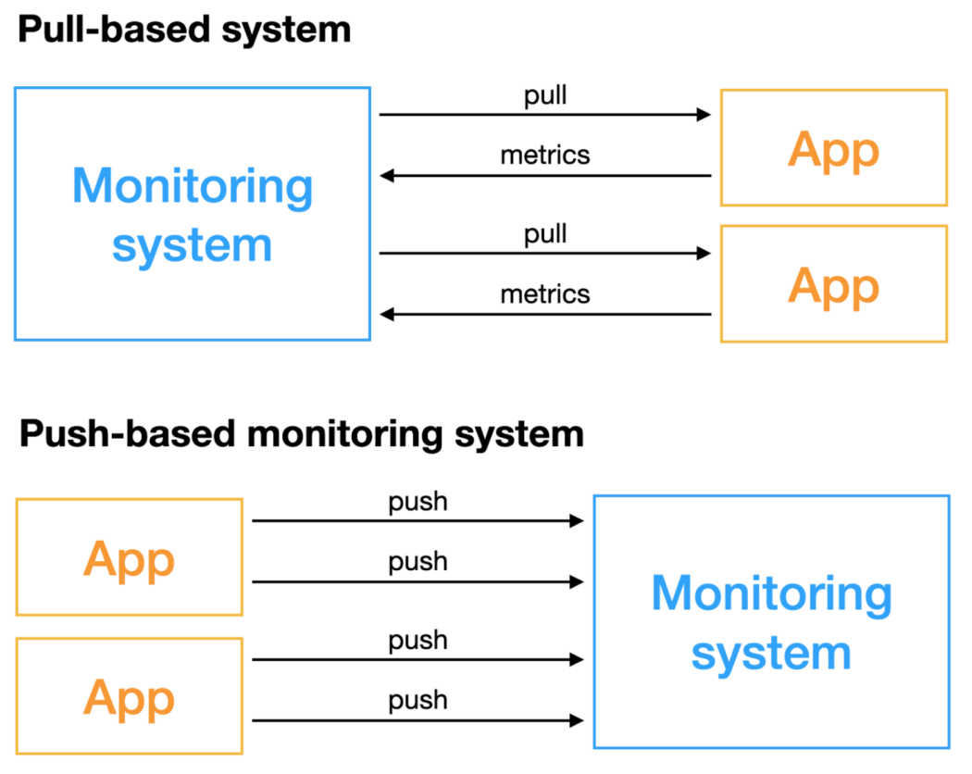
Types of Monitoring Systems

Slide 38
Types of Monitoring Systems
The Pull-based monitoring system actively obtains indicators, and the objects.
Monitoring system should have the capability to be accessed remotely.
Push-based monitoring systems do not actively obtain data, but the monitored objects actively push indicators.
There are differences between the two methods in many aspects.
For the construction and selection of monitoring systems, we must understand the advantages and disadvantages of these two methods in advance and choose the appropriate scheme for implementation.

Slide 39
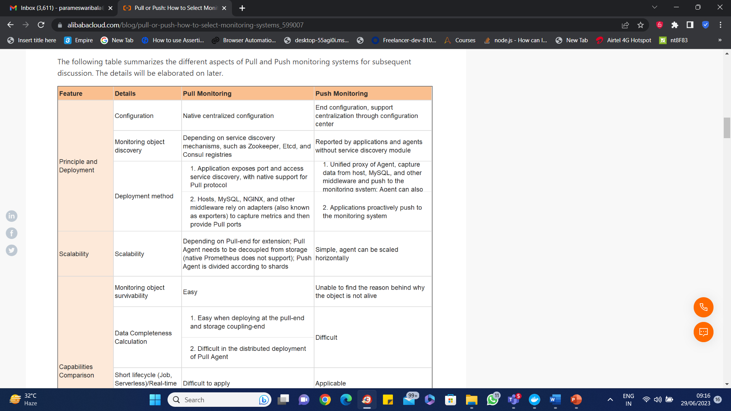
Types of Monitoring Systems

Slide 40
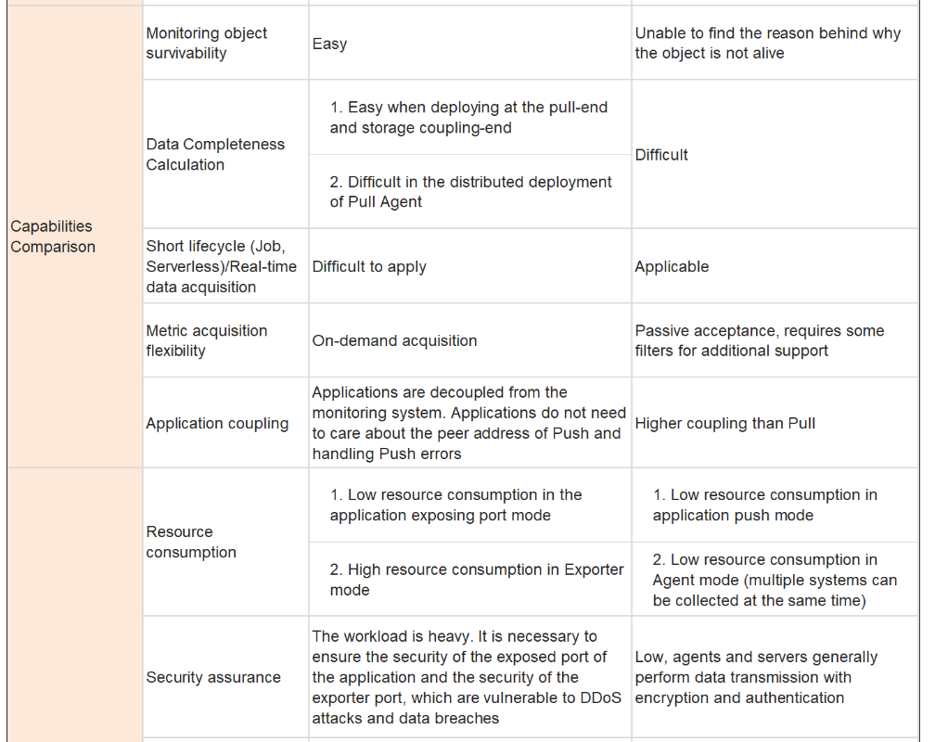
Types of Monitoring Systems

Slide 41
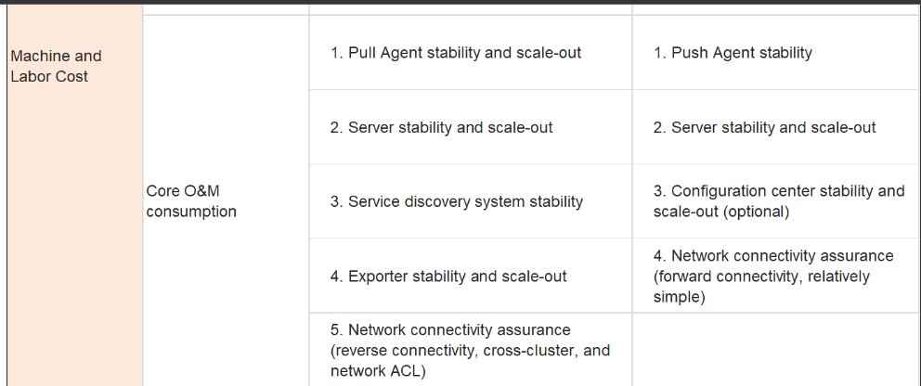
Types of Monitoring Systems

Slide 42
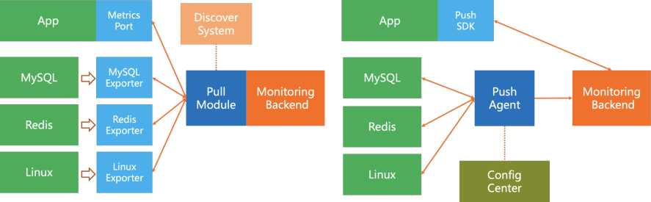
Types of Monitoring Systems
Pull Model Architecture

Slide 43
Types of Monitoring Systems
Pull Architecture
Service discovery system, including host service discovery (generally depends on the company's CMDB system), application service discovery (such as Consul), and PaaS service discovery (such as Kubernetes).
The pull module needs to have the capability to connect to these service discovery systems.
In addition to the service discovery part, the Pull core module generally uses the common protocol to pull data from the remote end.
It usually supports configuration pull interval, timeout interval, metric filtering, rename, and simple process capabilities.
The application-end SDK supports listening to a fixed port to provide the capability to be pulled.
Since various middleware and other systems are incompatible with the Pull protocol, it is necessary to develop an Agent corresponding to Exporter to support pulling the metrics of these systems and provide standard Pull interfaces.

Slide 44
Types of Monitoring Systems
Push Model Architecture
The Push model is simple and can be described as follows.
Push Agent supports pulling the metric data of various monitored objects and pushing them to the server.
It can be deployed in a manner coupled with the monitoring system or deployed separately.
ConfigCenter (optional) can provide centralized dynamic configuration capabilities, such as monitoring targets, collection intervals, metric filtering, metric processing, and remote targets.
The application-end SDK supports sending data to the monitoring backend or the local agent (usually, the local agent also implements a set of backend interfaces).

Slide 45
Prometheus Push gateway
Prometheus is a primarily pull-based monitoring system.
An additional component called the "Push gateway" is available for pushing metrics from external applications and services.
The Push gateway is useful for collecting metrics from systems that are not compatible with the otherwise pull-based infrastructure.
For instance, short-lived batch jobs that are ephemeral in nature may start and end before Prometheus can discover and scrape metrics from them.
The Prometheus Pushgateway can be used to push the metrics of such processes to prevent losing essential data before they get a chance to get scraped.

Slide 46
Prometheus Client Libraries
Applications only generate metrics after we add instrumentation to their code.
We can do this via one of the Prometheus client libraries.
Prometheus official client libraries are compatible with Java/JVM, Go, Python, and Ruby.
Third-party client libraries are also available for Node.js, Haskell, C#/.Net, Common Lisp, Dart, Erlang, Rust, and more.
Choose a Prometheus client library that matches the language of our application.

Slide 47
Prometheus Alert manager
The Alert manager handles alerts sent by client applications such as the Prometheus server.
In practice, the Prometheus server generates alerts when an alert condition is met in a user-defined alerting rule.
Alert manager then manages those alerts, sending notifications via one of eight built-in notification receivers: email, PagerDuty, PushOver, Slack, OpsGenie, VictorOps, WeChat, and Webhooks.
Once configured, Alertmanager instances handle deduplicating, grouping, inhibition, silencing, and routing of alerts to the correct receiver.

Slide 48
Prometheus Alert manager
Prometheus alerting is separated into two parts (alerting rules and alert processing).
Configuring Alert manager is only half of the battle.
The bulk of the business logic around alerting in Prometheus is based on alerting rules.
It can be configured in Prometheus itself.
Alerting rules are PromQL expressions that are evaluated at regular intervals by the Prometheus server.
By default, all Prometheus rules (recording rules and alerting rules) are evaluated on a 1m interval, but this is configurable (see the evaluation_interval parameter).

Slide 49
Prometheus Alert manager
Alert Manager is a single binary which handles alerts sent by Prometheus server and notifies end user through E-mail, Slack or other tools.
Monitoring helps predict potential problem or notify for current problem in our system and gives detail regarding the problem.
Alerting helps notify as soon as the problem occurs and allow teams to identify problem through notifications.

Slide 50
Prometheus Alert manager
Alerting with Prometheus setup steps are mentioned below:
Setup and configure Alert Manager.
Configure the config file on Prometheus so it can talk to the Alert Manager.
Define alert rules in Prometheus server configuration.
Define alert mechanism in Alert Manager to send alerts via Slack and Mail.

Slide 51
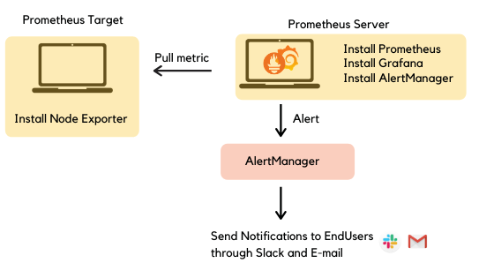
Prometheus Alert manager

Slide 52
Prometheus Alert manager
Alert Manager which manages the alerts through its pipeline of silencing, inhibition, grouping and sending out notifications.
Silencing is to mute alerts for a given time.
Alerts are checked to match against active silent alerts, if a match is found then no notifications are sent.
Inhibition is to suppress notifications for certain alerts if other alerts are already fired.
Grouping group alerts of similar nature into a single notification.
This helps prevent firing multiple notifications simultaneously to the receivers like Mail or Slack.

Slide 53
Configuring Prometheus to monitor itself
Prometheus collects metrics from targets by scraping metrics HTTP endpoints.
Since Prometheus exposes data to itself, it can also scrape and monitor its own health.

Slide 54
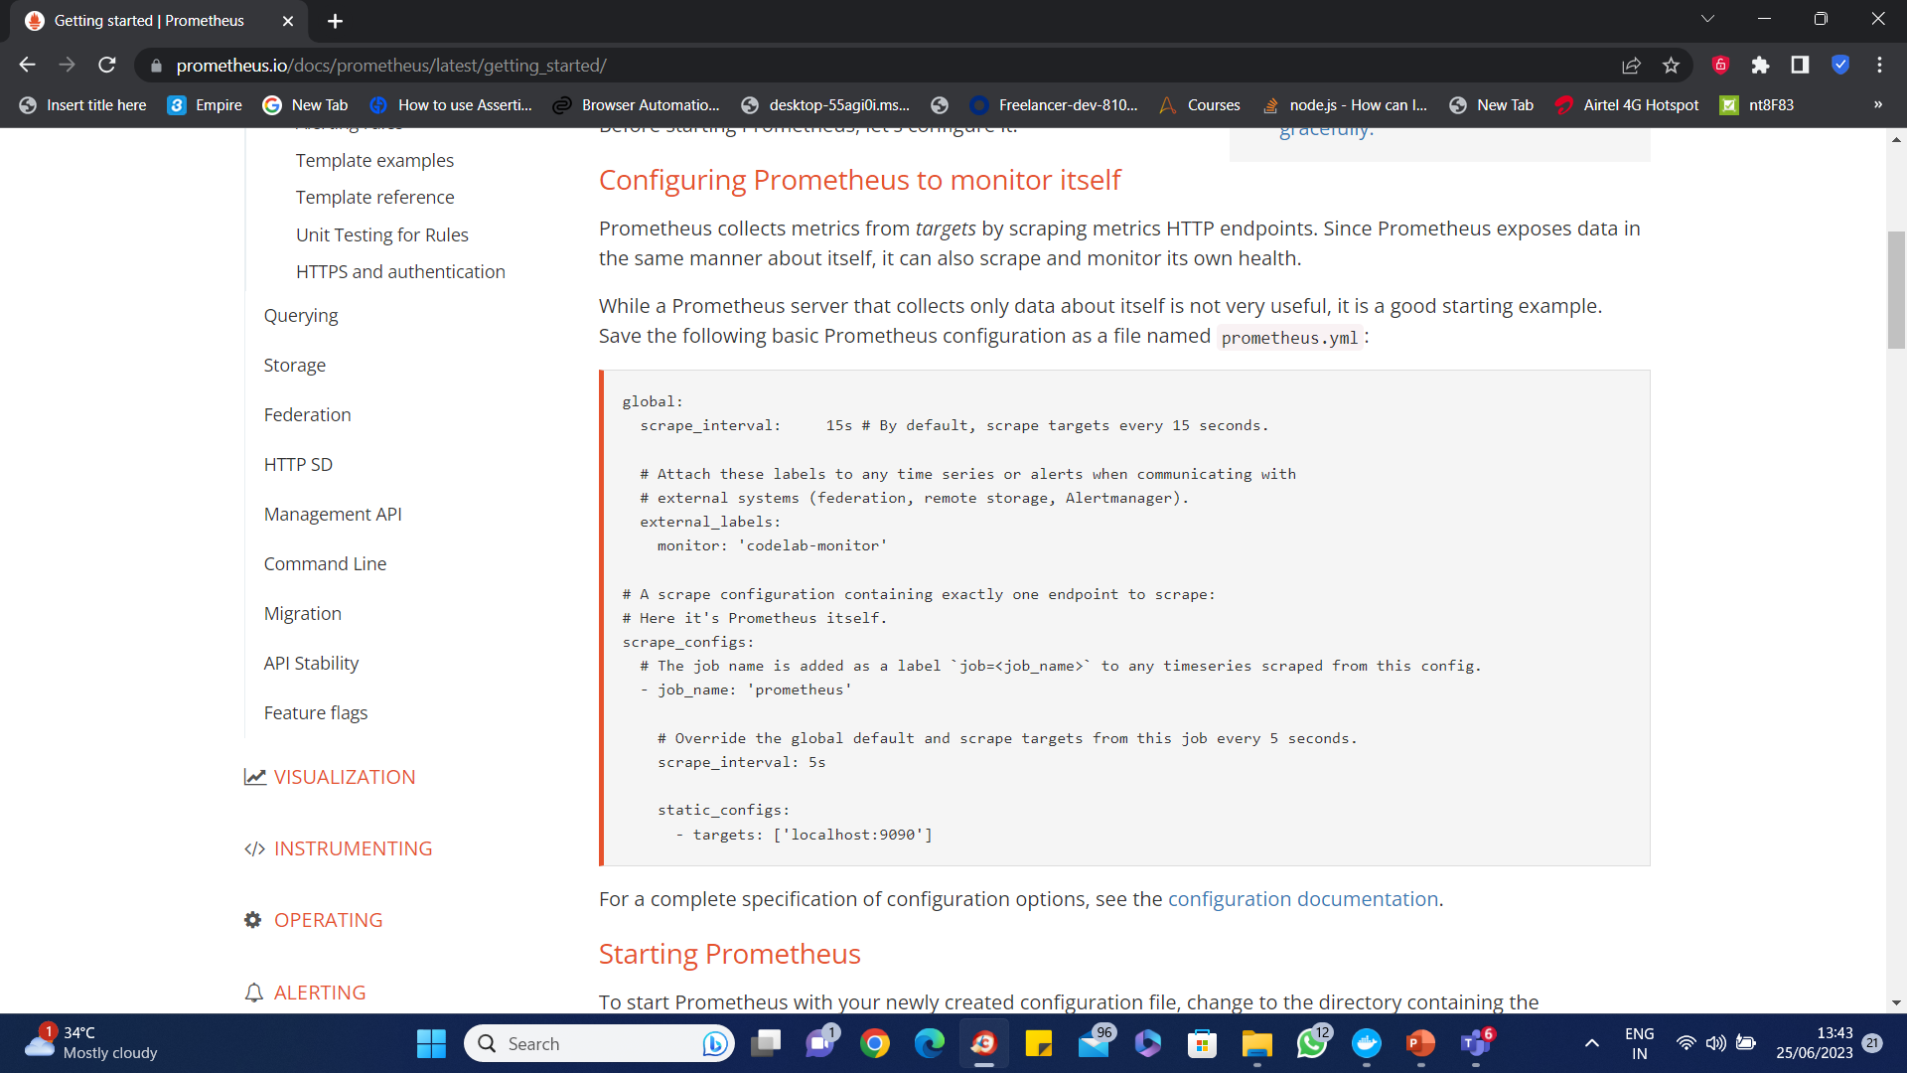
Configuring Prometheus to monitor itself

Slide 55
Start the Prometheus
prometheus.exe --config.file="prometheus.yml" --web.listen-address=:9092
Refer project
D:\git\ericmay2021repo\productdockerapi

Slide 56
Prometheus Web UI & Visualizations
The Prometheus web app includes a built-in utility.
It describes as an “expression browser” which provides direct access to enter any expression and visualize its result either in a table or graphed over time.

Slide 57
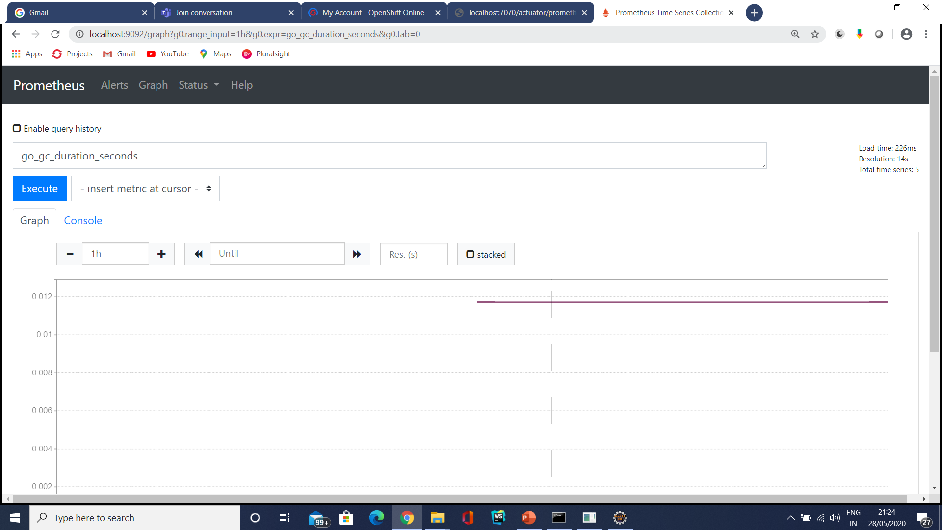
Prometheus

Slide 58
Custom Metrics
We can also define some custom metrics.
The demo contains a Scheduler class which periodically runs the included scheduling Task method.
To be able to send custom metrics we need to import Meter Registry from the Micrometer library and inject it into our class.

Slide 59
Custom Metrics
It is possible to instantiate these types of meters from MeterRegistry:
Counter: reports merely a count over a specified property of an application
Gauge: shows the current value of a meter
Timers: measures latencies or frequency of events
DistributionSummary: provides distribution of events and a simple summary
Refer implementation of a counter and a gauge for demonstration purposes

Slide 60
Prometheus Query
Counters
Counter metrics are used for measurements that only increase.
Therefore, they are always cumulative—their value can only go up.
The only exception is when the counter is restarted, in which case its value is reset to zero.
The actual value of a counter is not typically very useful on its own.
A counter value is often used to compute the delta between two timestamps or the rate of change over time.

Slide 61
Prometheus Query
Counters
The PromQL query below calculates the average requests per second over the last five minutes
rate(prometheus_http_requests_total[5m])
To calculate the absolute change over a time period, we would use a delta function which in PromQL is called increase():
increase(prometheus_http_requests_total[5m])

Slide 62
Prometheus Query
Counters
This would return the total number of requests made in the last five minutes, and it would be the same as multiplying the per second rate by the number of seconds in the interval (five minutes in our case):
rate(prometheus_http_requests_total[5m])*5*60
count_over_time(process_cpu_usage{instance="customer-app:7074"}[10m])

Slide 63
Prometheus Query
Gauges
Gauge metrics are used for measurements that can arbitrarily increase or decrease.
the actual value with no additional processing is meaningful and they are often used.
For example, metrics to measure temperature, CPU, and memory usage, or the size of a queue are gauges.

Slide 64
Prometheus Query
avg_over_time(application_ready_time_seconds{instance="customer-app:7074"}[5m])

Slide 65
Prometheus Query
Histograms
Histogram metrics are useful to represent a distribution of measurements.
They are often used to measure request duration or response size.
Histograms divide the entire range of measurements into a set of intervals—named buckets—and count how many measurements fall into each bucket.

Slide 66
Prometheus Query
Histograms
A histogram metric includes a few items:
A counter with the total number of measurements.
The metric name uses the _count suffix.
A counter with the sum of the values of all measurements.
The metric name uses the _sum suffix.
The histogram buckets are exposed as counters using the metric name with a _bucket suffix and a le label indicating the bucket upper inclusive bound.
Buckets in Prometheus are inclusive, that is a bucket with an upper bound of N (i.e., le label) includes all data points with a value less than or equal to N.

Slide 67
Prometheus Query
Histograms
http_server_requests_seconds_count{instance="customer-app:7074"}
prometheus_http_request_duration_seconds_bucket{instance="localhost:9090"}

Slide 68
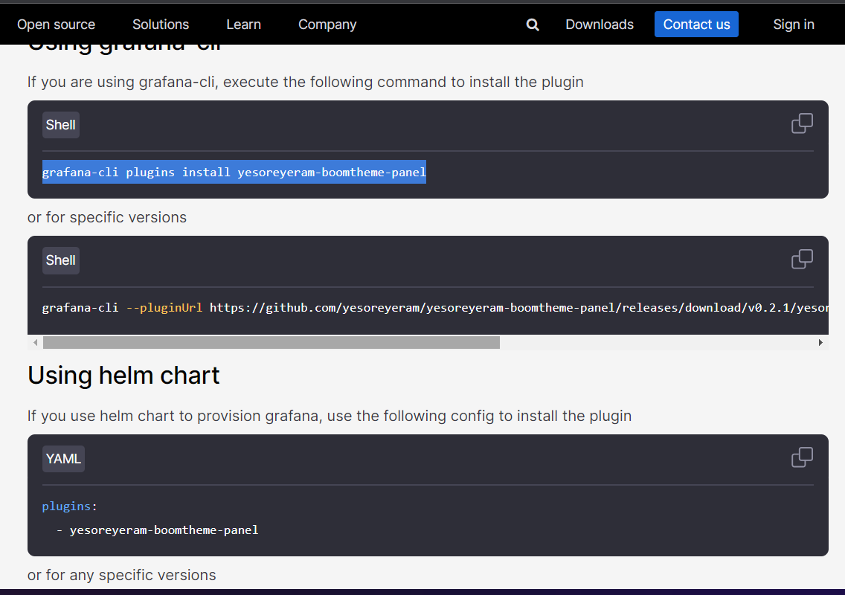
Grafana

Slide 69
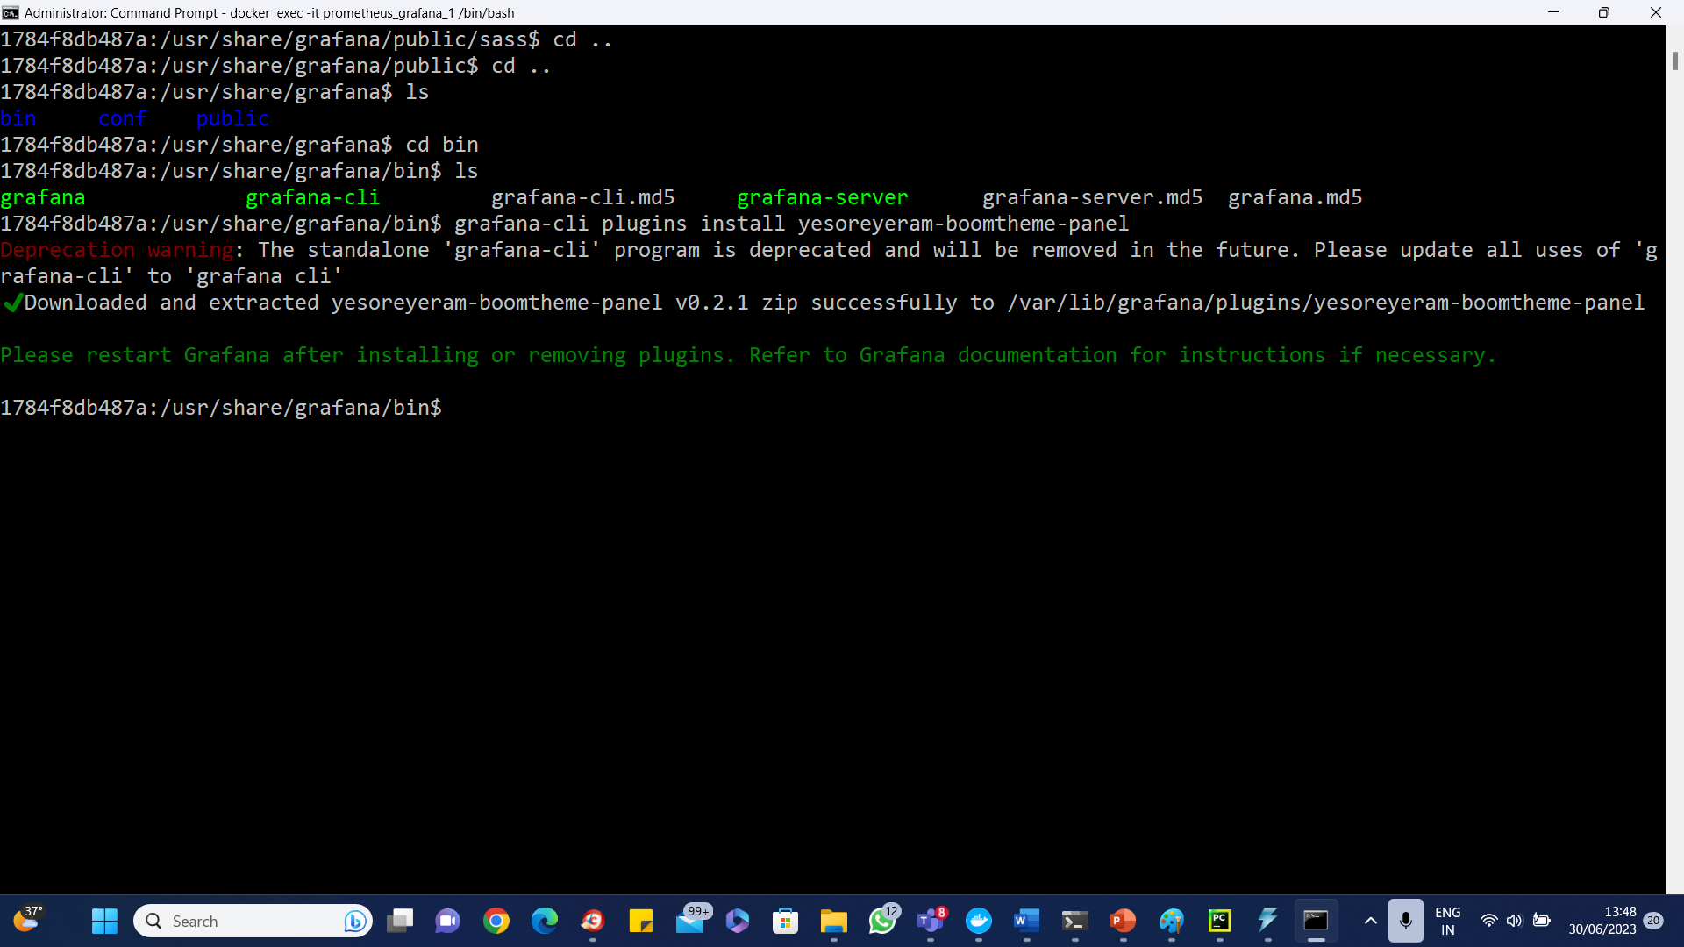
Grafana

Slide 70
Grafana
https://volkovlabs.io/blog/how-to-customize-the-grafana-user-interface-8d70a42dc2b6/

